Slide 1

Precedence graphs and correctness criteria
Database Management System | Transaction Management and Scheduling
Course: Database Management System | Chapter: Transaction Management and Scheduling | Program: B.TECH-CSE, B.TECH CSE - CYBER SECURITY, B.TECH CSE - DATA
DISCOVER · LEARN · EMPOWER
Notes:
Welcome everyone to today's lecture on Transaction Management. We will dive deep into how we verify if a schedule of transactions is correct using precedence graphs. This is a critical skill for ensuring data integrity in real-world database systems. Let us begin by understanding the core concepts of serializability.

Slide 2
Course Outcomes
SLIDE 2 / 14
Course Outcome
CO | BT LEVEL | DESCRIPTION
CO1 | BT2 | Explain database architecture, relational model concepts and formal query language foundations including relational algebra and relational calculus.
CO2 | BT3 | Apply relational algebra, relational calculus and SQL constructs to formulate correct and efficient database queries.
CO3 | BT4 | Analyze functional dependencies and design normalized relational schemas up to 5NF ensuring lossless join and dependency preservation.
CO4 | BT4 | Analyze transaction schedules and concurrency control mechanisms to determine serializability, recoverability and correctness.
CO5 | BT5 | Evaluate storage structures, indexing strategies and query optimization techniques for performance, scalability and reliability.
Chandigarh University
2 / 14
Notes:
Today's session directly supports our first two course outcomes. CO1 requires you to explain the foundational concepts of database architecture, which includes understanding how transactions interact. CO2 focuses on applying these concepts to formulate correct queries, ensuring that the underlying schedules are valid. Mastering precedence graphs is the bridge between theory and correct query execution.

Slide 3
Learning Objectives
SLIDE 3 / 14
Learning Outcomes
1
Define the concept of a precedence graph for a given schedule.
2
Construct a precedence graph by identifying conflicting operations between transactions.
3
Analyze a graph to determine if a schedule is conflict serializable.
4
Evaluate the necessity of acyclic graphs for ensuring schedule correctness.
5
Differentiate between serial schedules and conflict-equivalent serial schedules.
Chandigarh University
3 / 14
Notes:
By the end of this lecture, you will be able to define and construct precedence graphs for any given schedule. You will learn to analyze these graphs to determine if a schedule is conflict serializable. We will also evaluate why an acyclic graph is the strict requirement for correctness. Finally, you will differentiate between serial schedules and those that are conflict-equivalent.

Slide 4
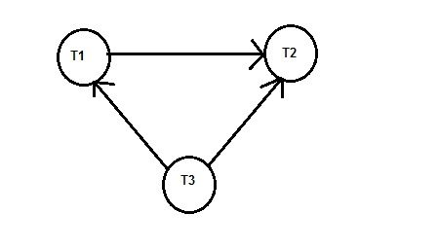
Lecture
SLIDE 4 / 14
Definition of Precedence Graph
1
A precedence graph is a directed graph representing dependencies between transactions.
2
Nodes in the graph represent individual transactions in the schedule.
3
Edges represent direct conflicts where one transaction must precede another.
4
An edge from T1 to T2 implies T1 must execute before T2.
5
The graph captures the order of conflicting read and write operations.
6
It serves as a visual tool to test for conflict serializability.
7
The graph is constructed by analyzing the sequence of operations.
Consider the three transactions t1 t2 and t3 and the schedules S given below: T1: r1(x);w1(x);r1(y);w1(y) T2:r2(z);r2(y);w2(y),r2(x),w2(x)
Chandigarh University
4 / 14
Notes:
Think of a precedence graph as a map of dependencies. Each node represents a transaction, and the arrows show which transaction must happen before another due to conflicts. If Transaction A writes a value that Transaction B reads, A must come before B. This graph helps us visualize the constraints imposed by the schedule.

Slide 5
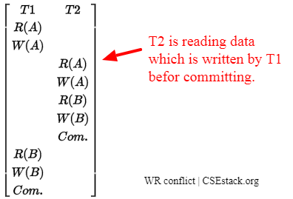
Lecture
SLIDE 5 / 14
Rules for Constructing Edges
1
Create an edge Ti → Tj if Ti writes X and Tj reads X.
2
Create an edge Ti → Tj if Ti writes X and Tj writes X.
3
Create an edge Ti → Tj if Ti reads X and Tj writes X.
4
Only conflicting operations on the same data item create edges.
5
Non-conflicting operations do not generate edges in the graph.
6
The direction of the edge follows the order in the schedule.
7
Multiple conflicts on the same item do not create duplicate edges.
Source: www.csestack.org
Chandigarh University
5 / 14
Notes:
We create edges based on three specific types of conflicts. First, if T1 writes X and T2 reads X, T1 must precede T2. Second, if both write X, the first writer must precede the second. Third, if T1 reads X and T2 writes X, T1 must precede T2. Non-conflicting operations, like two reads, do not create edges.

Slide 6
Lecture
SLIDE 6 / 14
Conflict Serializability Criterion
1
A schedule is conflict serializable if its precedence graph is acyclic.
2
An acyclic graph contains no cycles or loops in the edges.
3
If a cycle exists, the schedule is not conflict serializable.
4
Serializability ensures the schedule is equivalent to some serial order.
5
The criterion is necessary and sufficient for conflict serializability.
6
Cycles indicate a circular dependency that prevents serial execution.
7
Checking for cycles is the standard algorithm for verification.
Chandigarh University
6 / 14
Notes:
The golden rule is simple: a schedule is conflict serializable if and only if its precedence graph has no cycles. If you find a loop, like T1 to T2 to T3 and back to T1, the schedule is invalid. This cycle means the transactions are waiting on each other in a way that cannot be resolved into a serial order.

Slide 7
Worked Example
SLIDE 7 / 14
Schedule Setup
THE SEQUENCE OF OPERATIONS IS
W1(A), R2(A), W2(B), R1(B), W3(B), R3(A).
• Consider a schedule S with three transactions: T1, T2, T3.
• T1 writes A, T2 reads A, T3 writes B.
• T2 writes B, T1 reads B, T3 reads A.
• We must identify all conflicting pairs to build the graph.
• List the operations in order to trace dependencies accurately.
• This example will demonstrate the step-by-step construction process.
Chandigarh University
7 / 14
Notes:
Let's look at a concrete example. We have three transactions with interleaved operations on items A and B. T1 writes A, then T2 reads it. Later, T2 writes B, and T1 reads it. We also have T3 writing and reading B and A. We need to map these interactions to find the dependencies.

Slide 8
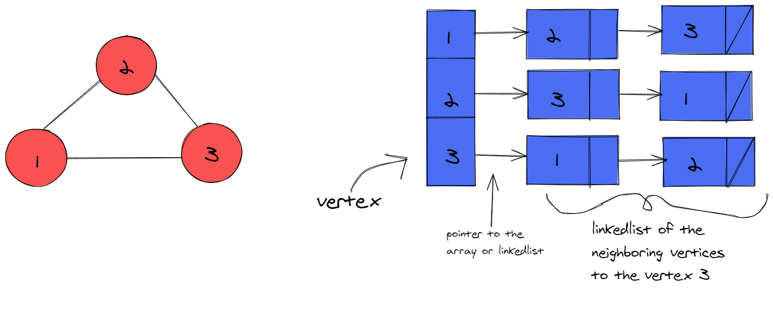
Worked Example
SLIDE 8 / 14
Identifying Conflicts
1
Conflict 1: W1(A) and R2(A) creates edge T1 → T2.
2
Conflict 2: R2(B) and W2(B) is not a conflict between different transactions.
3
Conflict 3: W2(B) and R1(B) creates edge T2 → T1.
4
Conflict 4: W3(B) and R3(B) is within the same transaction.
5
Conflict 5: R3(A) and W1(A) creates edge T1 → T3.
6
Conflict 6: W3(B) and W2(B) creates edge T2 → T3.
7
We have identified four distinct edges between the transactions.
Source: storage.googleapis.com
Chandigarh University
8 / 14
Notes:
Let's identify the conflicts. T1 writes A and T2 reads it, so T1 must come before T2. T2 writes B and T1 reads it, so T2 must come before T1. T3 reads A after T1 writes it, so T1 must come before T3. T2 writes B before T3 writes it, so T2 must come before T3. These are the edges we will draw.

Slide 9
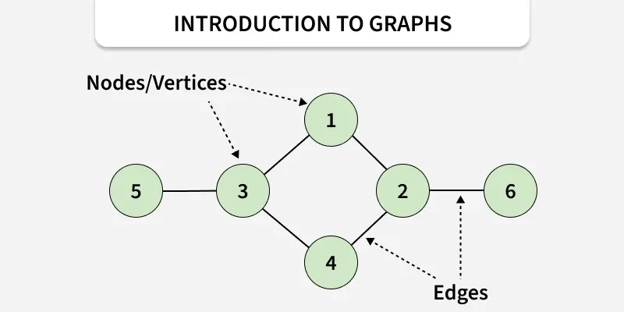
Worked Example
SLIDE 9 / 14
Graph Construction
THE GRAPH NOW CONTAINS EDGES
T1→T2, T2→T1, T1→T3, T2→T3.
• Draw nodes T1, T2, and T3 on the slide.
• Draw an arrow from T1 to T2 based on the A conflict.
• Draw an arrow from T2 to T1 based on the B conflict.
• Draw an arrow from T1 to T3 based on the A read.
• Draw an arrow from T2 to T3 based on the B write.
• Visually inspect the graph for any closed loops or cycles.
Source: media.geeksforgeeks.org
Chandigarh University
9 / 14
Notes:
Now we draw the graph. We place T1, T2, and T3 as nodes. We draw an arrow from T1 to T2, and another from T2 back to T1. This immediately creates a loop between T1 and T2. We also add arrows to T3 from both T1 and T2. The visual representation makes the cycle obvious.

Slide 10
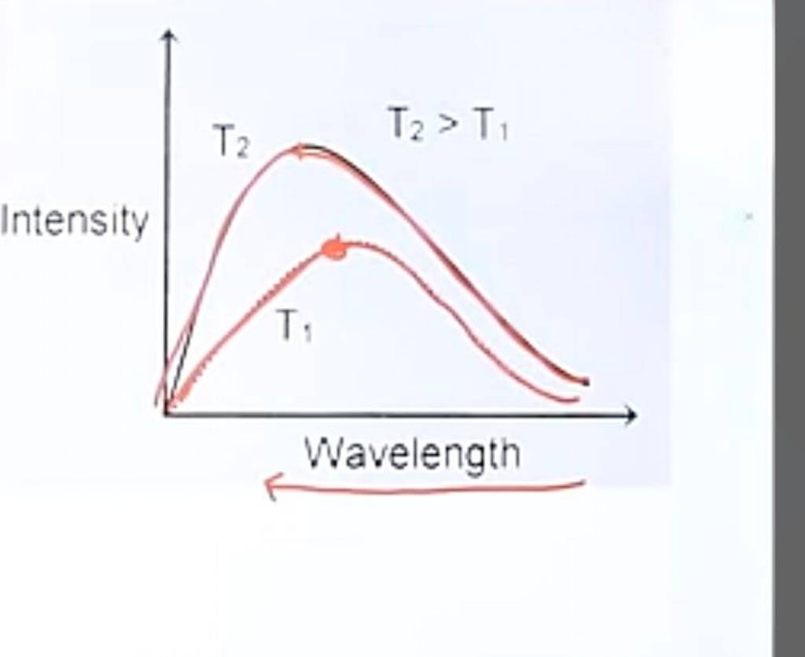
Worked Example
SLIDE 10 / 14
Cycle Detection
1
Observe the path T1 → T2 → T1 in the graph.
2
This path forms a cycle of length two.
3
A cycle indicates a circular dependency between T1 and T2.
4
The presence of this cycle violates the acyclic condition.
5
Therefore, the schedule S is not conflict serializable.
6
No serial order can satisfy the conflicting requirements of T1 and T2.
7
The schedule must be rejected or modified by the DBMS.
Source: classroom-images.cdn.askfilo.com
Chandigarh University
10 / 14
Notes:
Look closely at the graph. We have a path from T1 to T2 and back to T1. This is a cycle. Because a cycle exists, the schedule is not conflict serializable. This means there is no way to reorder these transactions into a serial sequence that produces the same result. The DBMS must handle this by aborting one of the transactions.

Slide 11
Lecture
SLIDE 11 / 14
Common Pitfalls in Analysis
1
Ignoring non-conflicting operations when building the graph.
2
Misinterpreting the direction of edges based on operation order.
3
Failing to check for cycles in larger graphs with many nodes.
4
Confusing conflict serializability with view serializability criteria.
5
Assuming that a serial schedule is always conflict serializable.
6
Overlooking multiple conflicts on the same data item.
7
Drawing edges for operations that do not conflict.
Chandigarh University
11 / 14
Notes:
Students often make mistakes here. A common error is drawing edges for non-conflicting operations, like two reads. Another is getting the direction wrong; remember, the earlier operation points to the later one. Also, do not confuse conflict serializability with view serializability, which is a broader but more complex concept. Always double-check for cycles.

Slide 12
Lecture
SLIDE 12 / 14
Why Correctness Matters
1
Correctness ensures the database remains in a consistent state.
2
Incorrect schedules can lead to lost updates or dirty reads.
3
Serializability guarantees that concurrent execution mimics serial execution.
4
It prevents anomalies that violate the ACID properties of transactions.
5
Without correctness criteria, data integrity cannot be assured.
6
The precedence graph provides a formal proof of correctness.
7
It allows the DBMS to enforce concurrency control protocols.
Chandigarh University
12 / 14
Notes:
Why do we care about these graphs? Because they ensure data consistency. Without conflict serializability, we risk lost updates or dirty reads, which violate the ACID properties. The precedence graph provides a formal way to prove that a concurrent schedule is safe. It allows the database system to enforce protocols that maintain data integrity.

Slide 13
Lecture
SLIDE 13 / 14
Key Takeaways
1
Precedence graphs map transaction dependencies using directed edges.
2
Edges are created only by conflicting read and write operations.
3
A schedule is conflict serializable if and only if the graph is acyclic.
4
Cycles in the graph indicate a non-serializable and invalid schedule.
5
This method is essential for ensuring database consistency and correctness.
Chandigarh University
13 / 14
Notes:
To summarize, precedence graphs are our tool for checking schedule validity. We build them by mapping conflicts between transactions. The key takeaway is the acyclic condition: no cycles means the schedule is safe. If you find a cycle, the schedule is invalid. This is fundamental to maintaining database consistency.

Slide 14
Lecture
SLIDE 14 / 14
References
1
Fundamentals of Database Systems — Ramez Elmasri & Shamkant B. Navathe
2
Database System Concepts — Silberschatz, Korth & Sudarshan
3
Database Management Systems — Raghu Ramakrishnan & Johannes Gehrke
4
Oracle/MySQL Documentation — Oracle
Chandigarh University
14 / 14
Notes:
For further reading, I recommend the standard texts by Elmasri and Navathe, as well as Silberschatz. Ramakrishnan's book also provides excellent coverage of these topics. Finally, the Oracle and MySQL documentation offers practical insights into how these concepts are implemented in real systems. Thank you for your attention.

